Slide 1


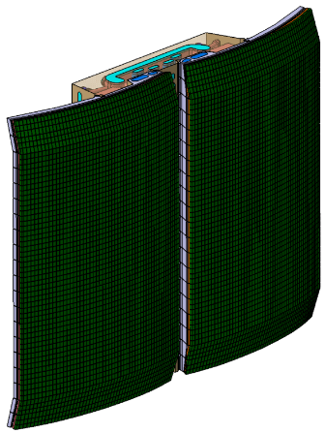
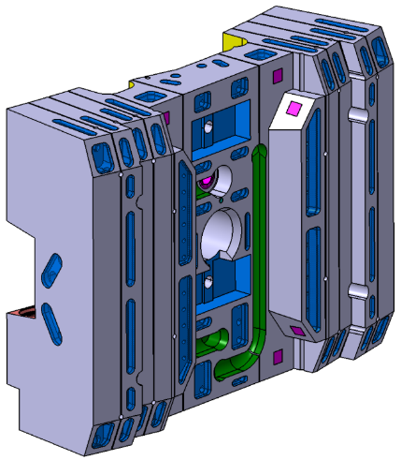
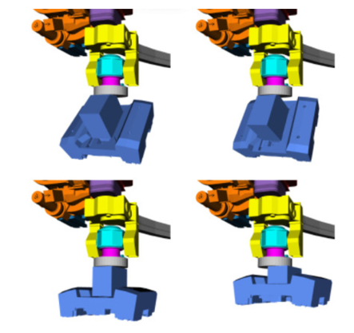
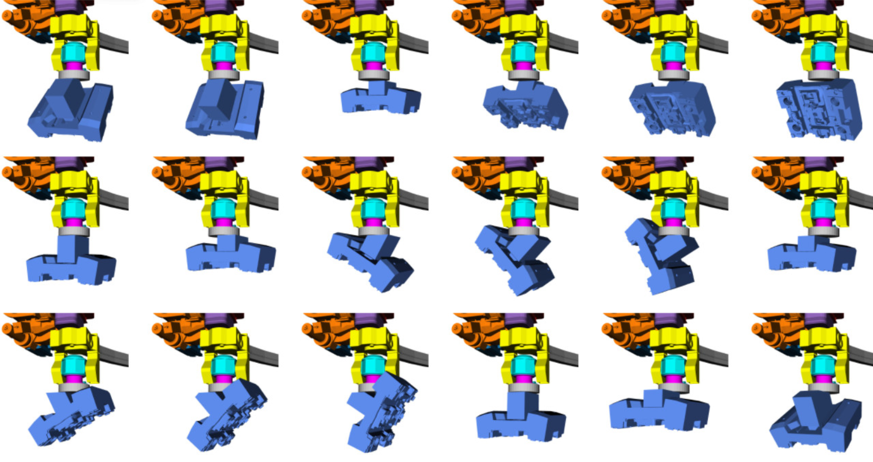
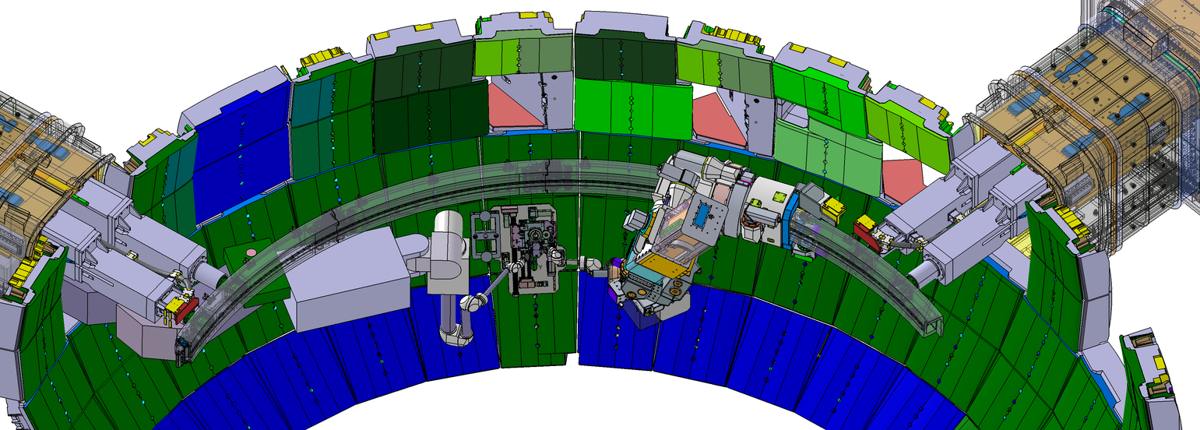
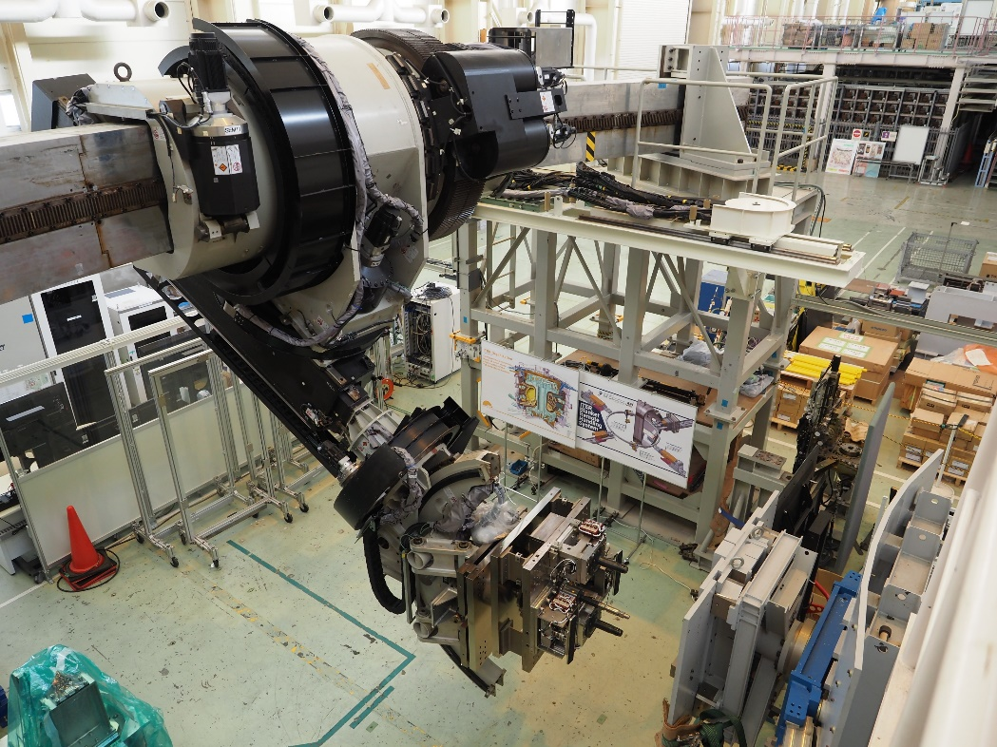
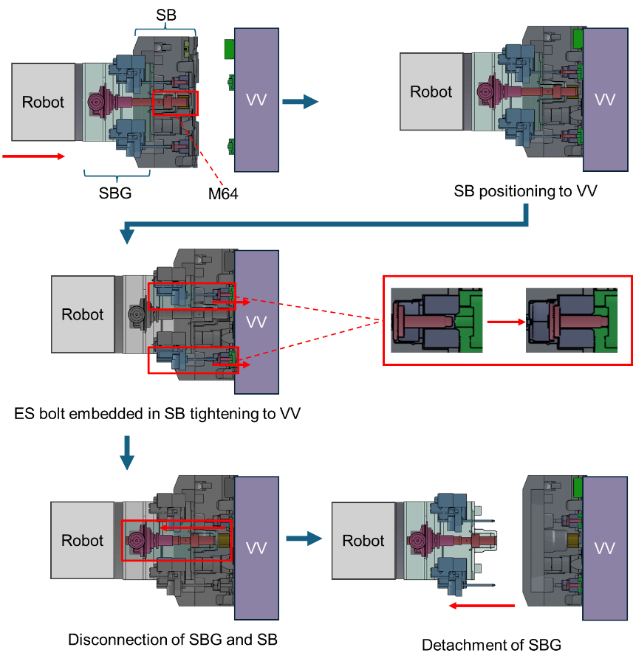
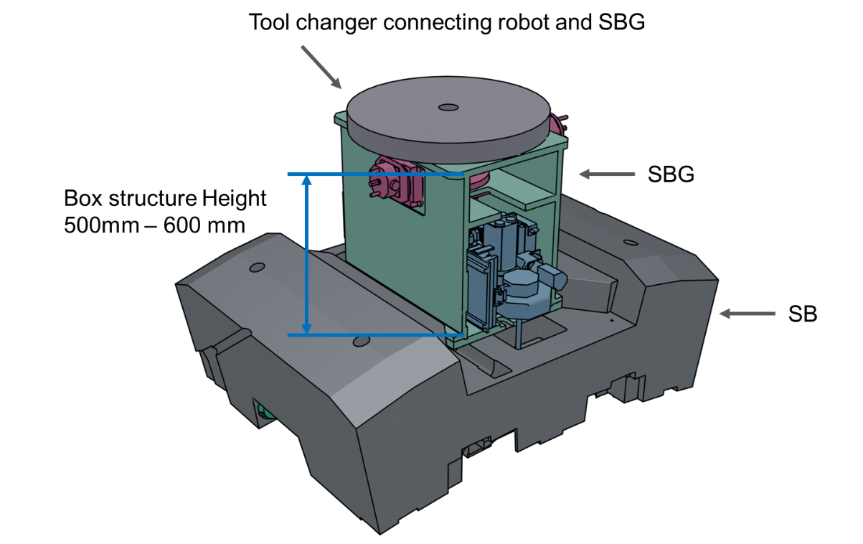
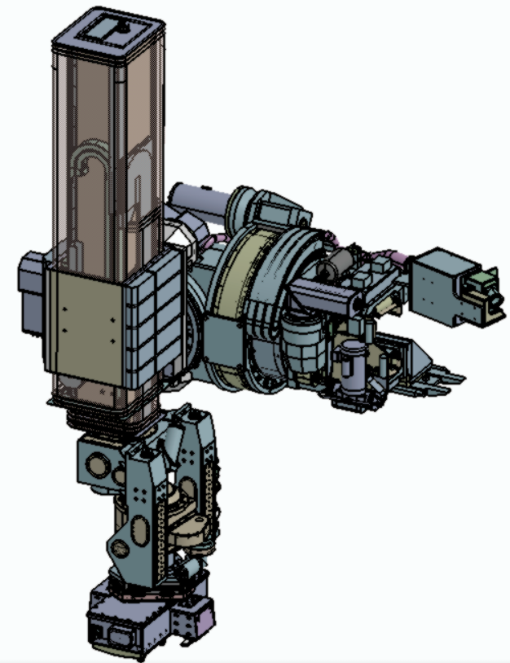
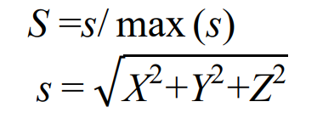
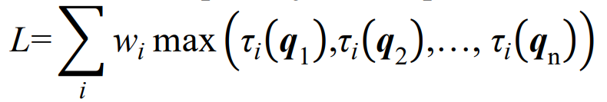
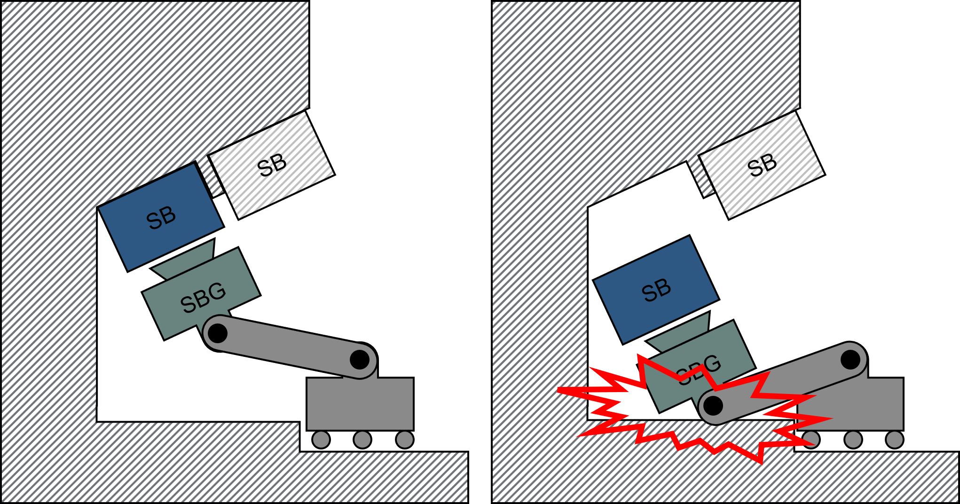
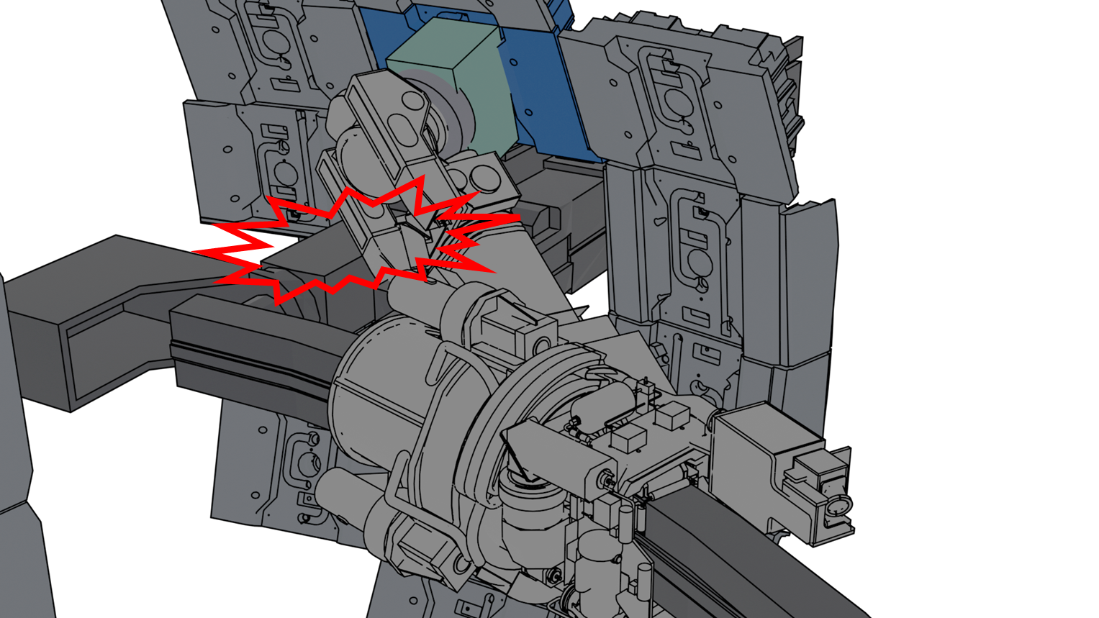
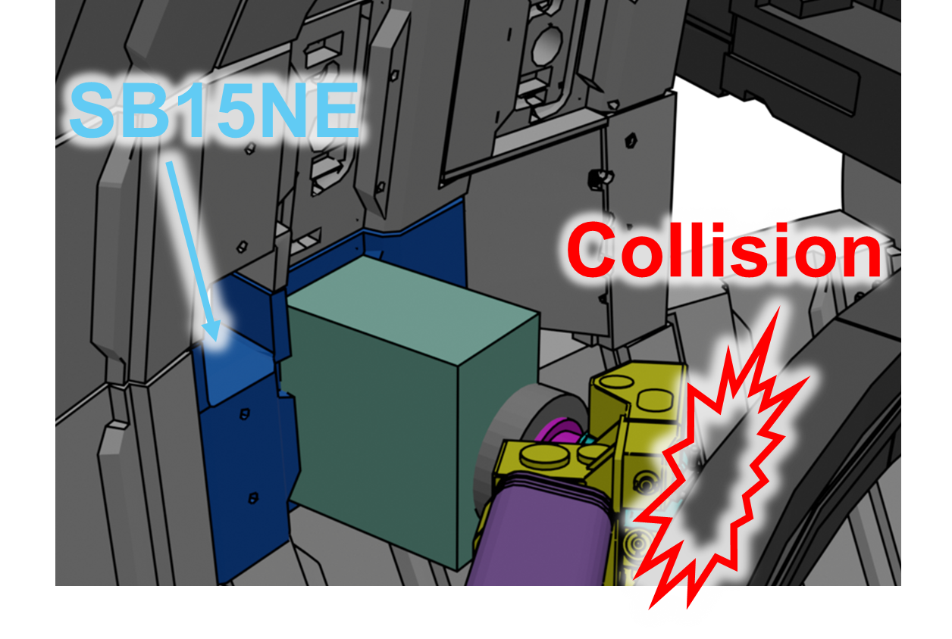
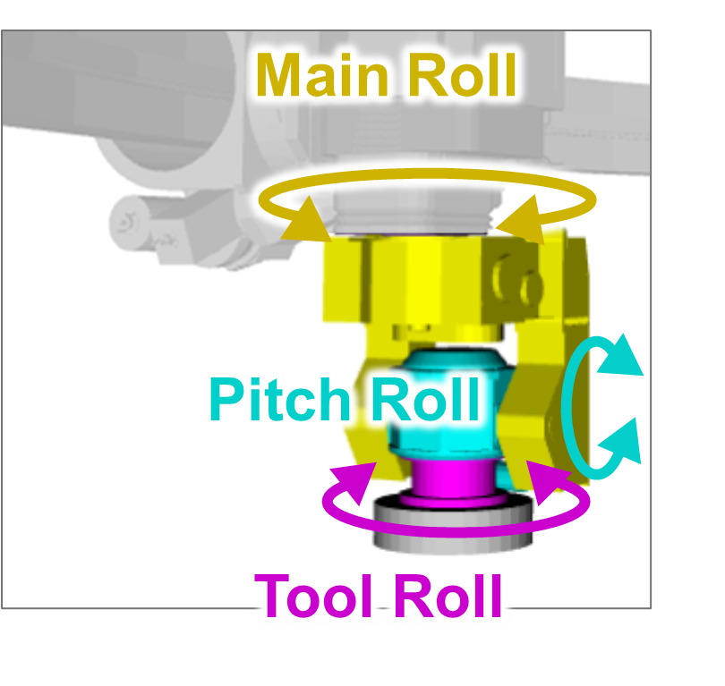
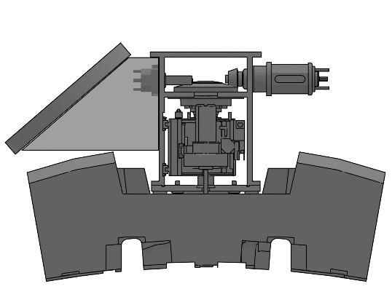
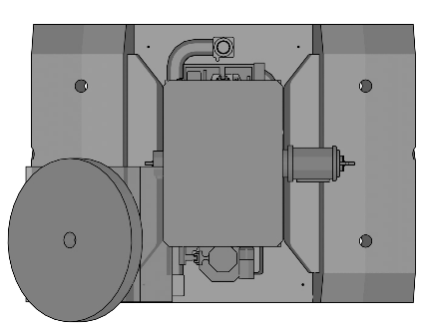
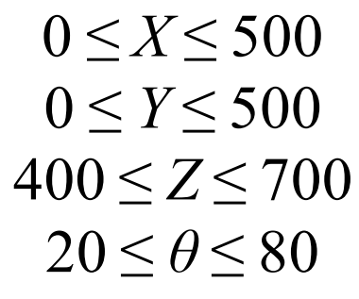
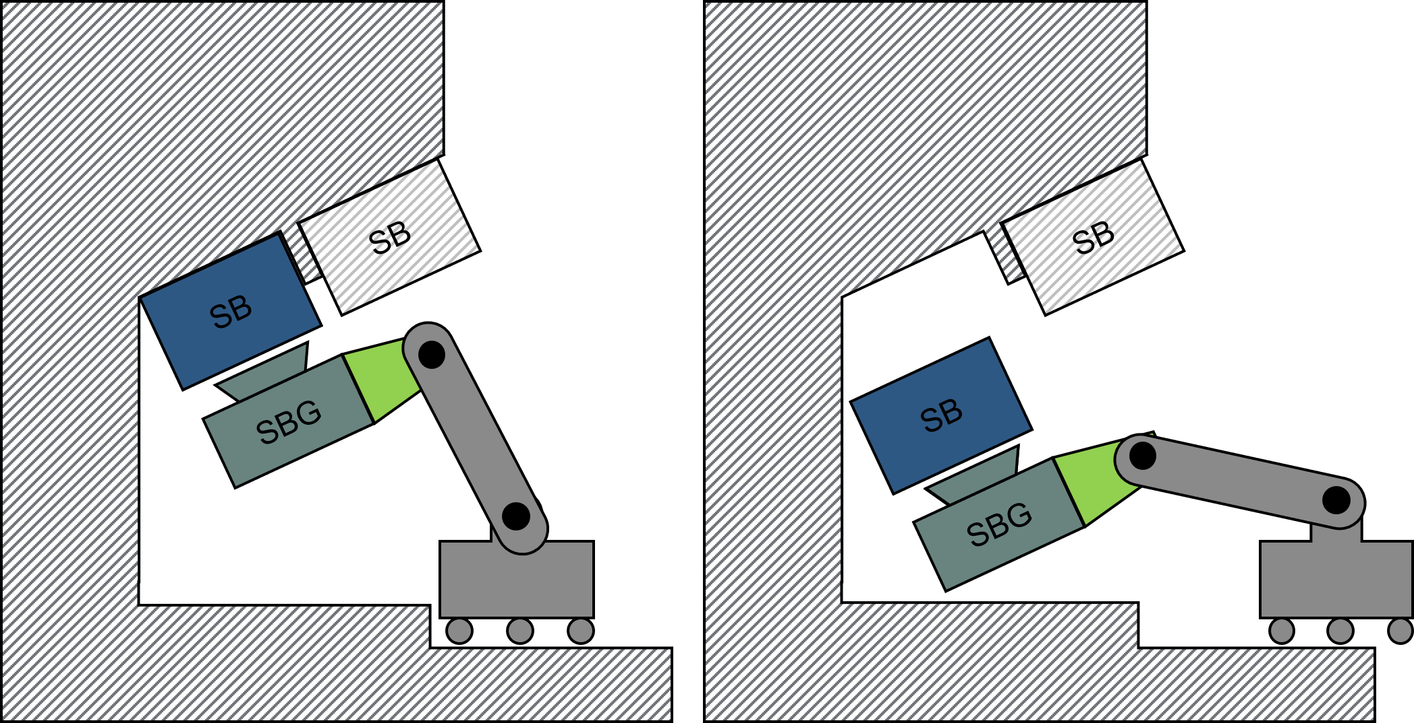
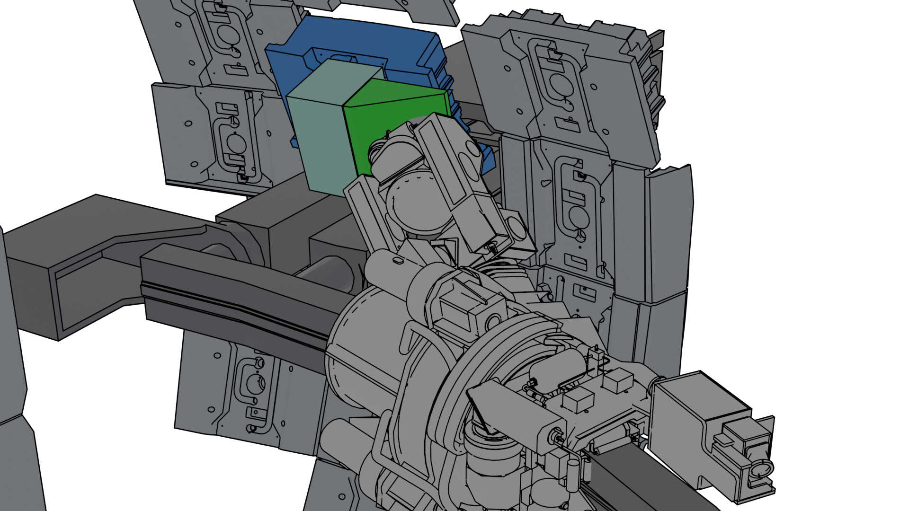
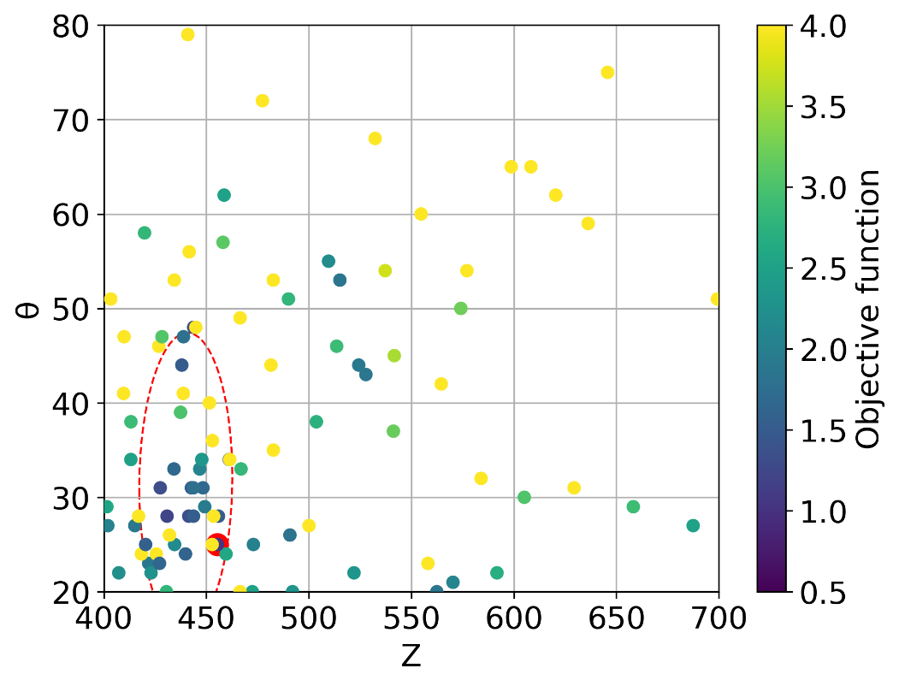
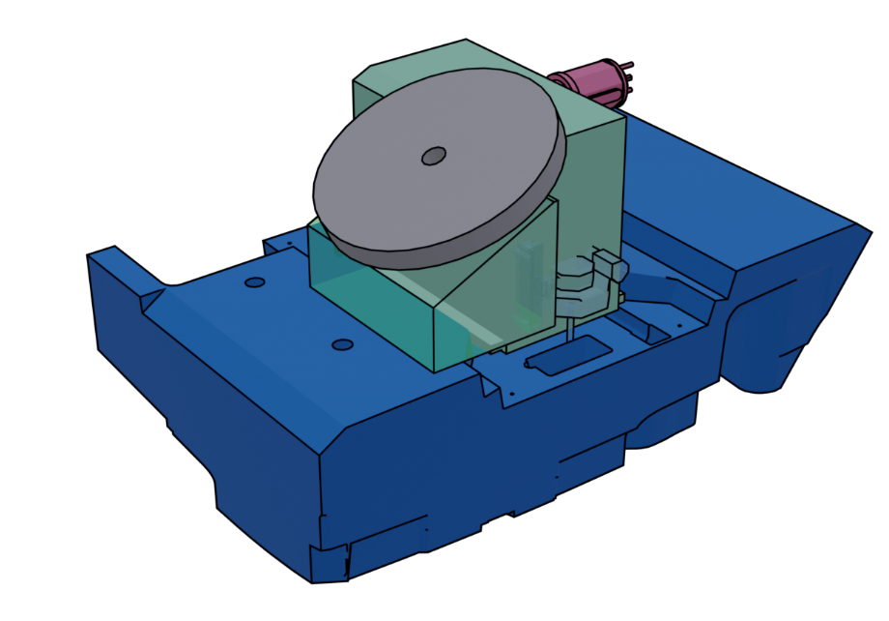
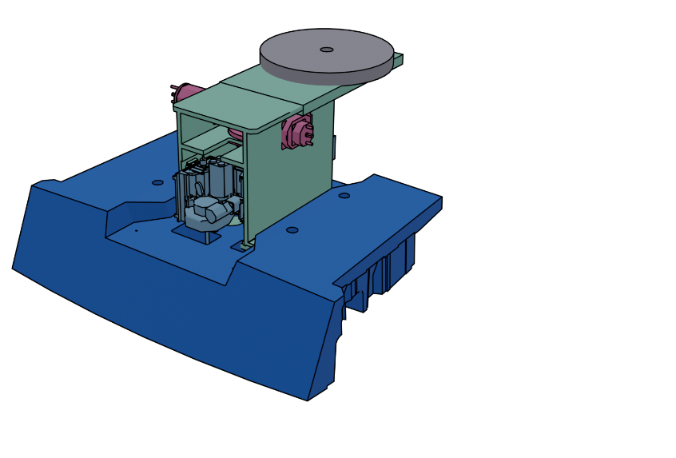
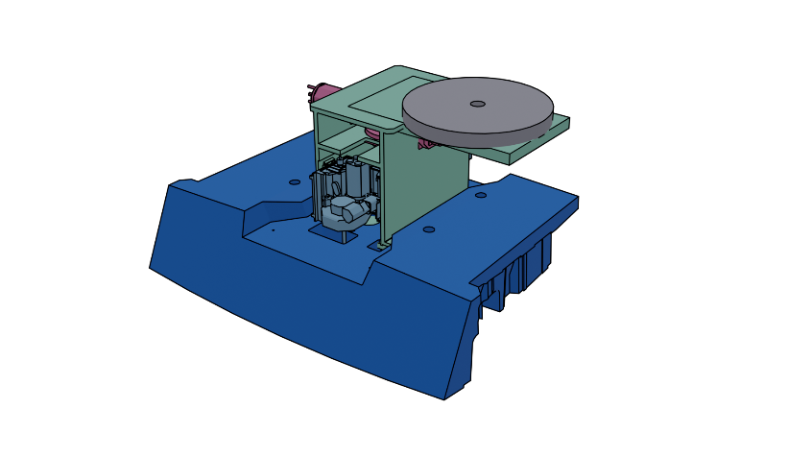
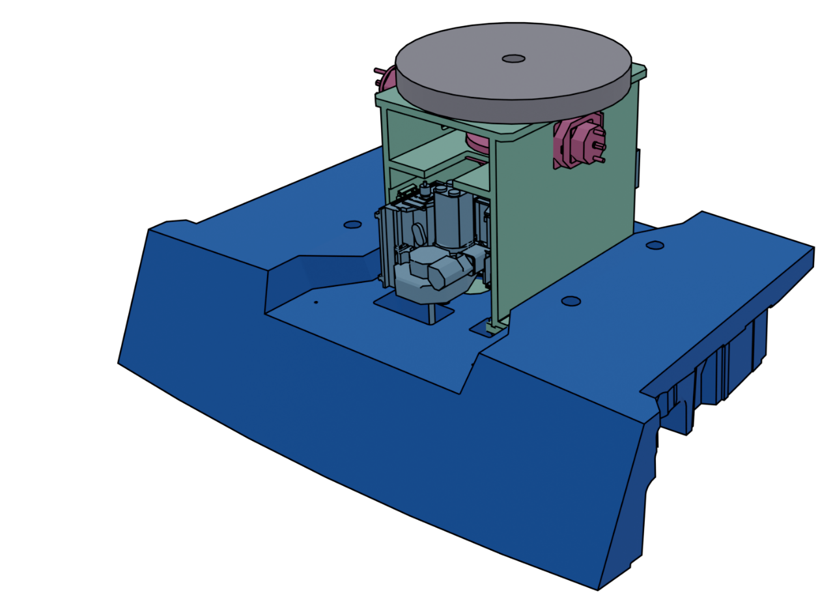
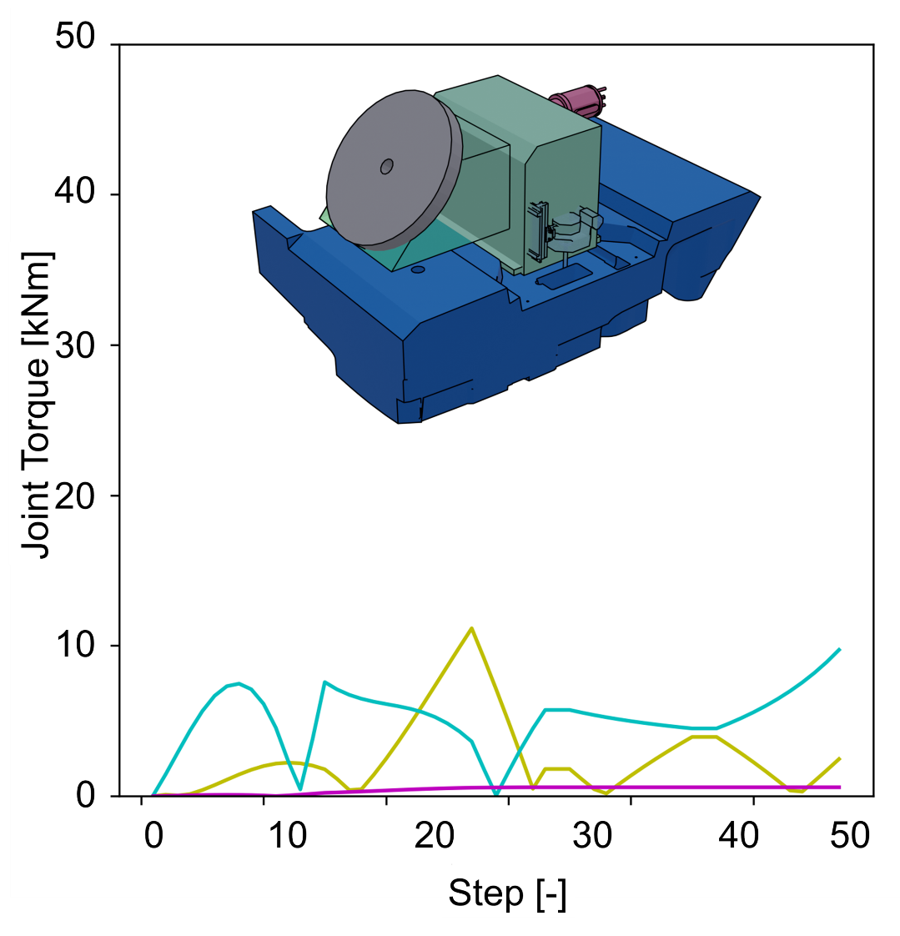
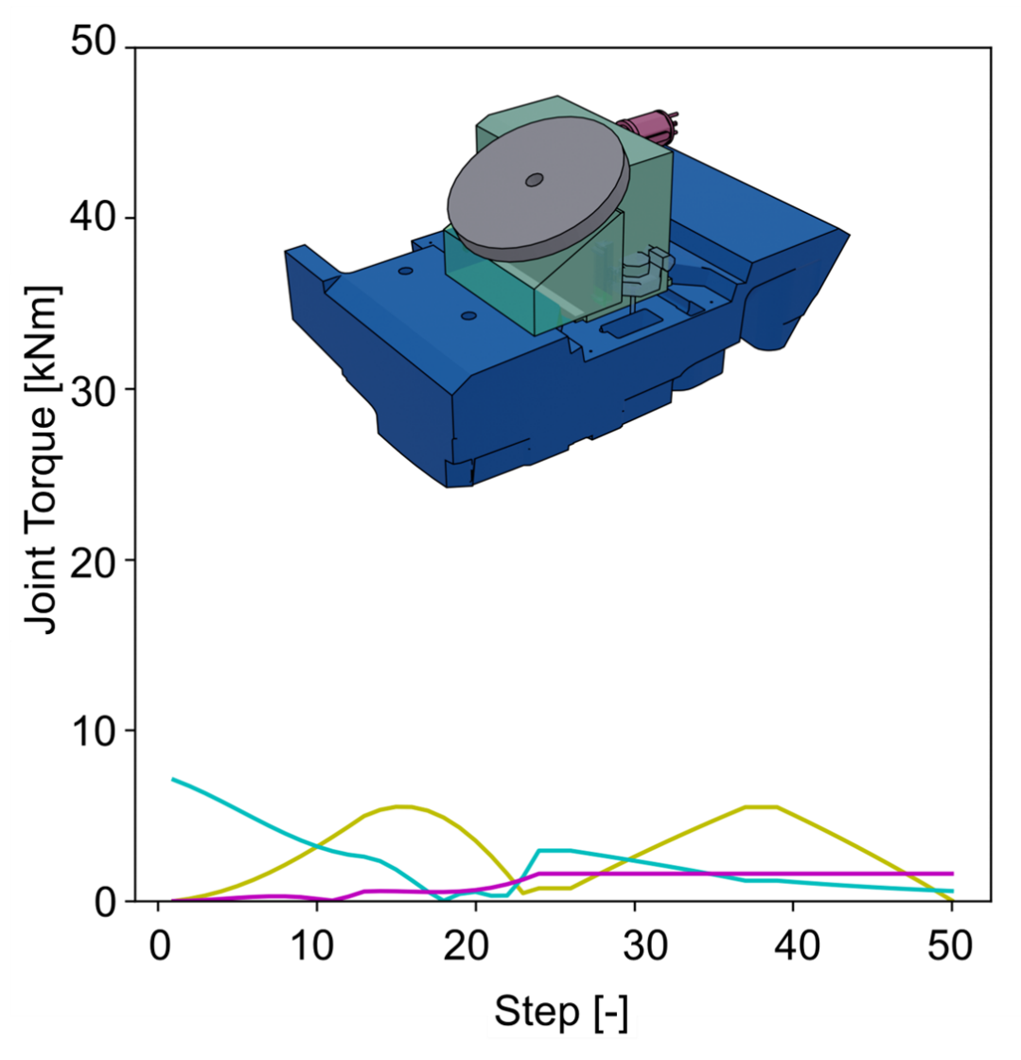
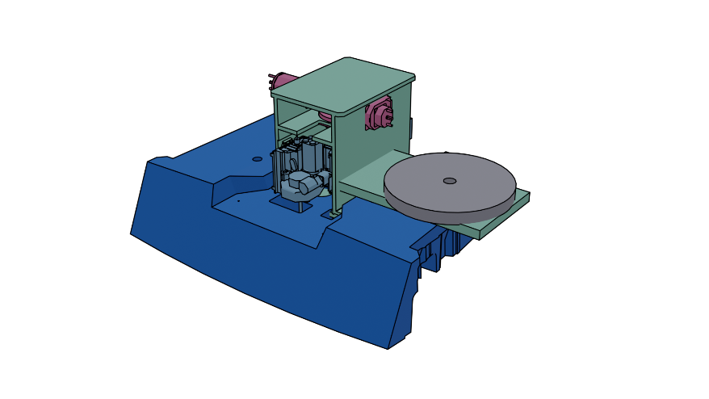
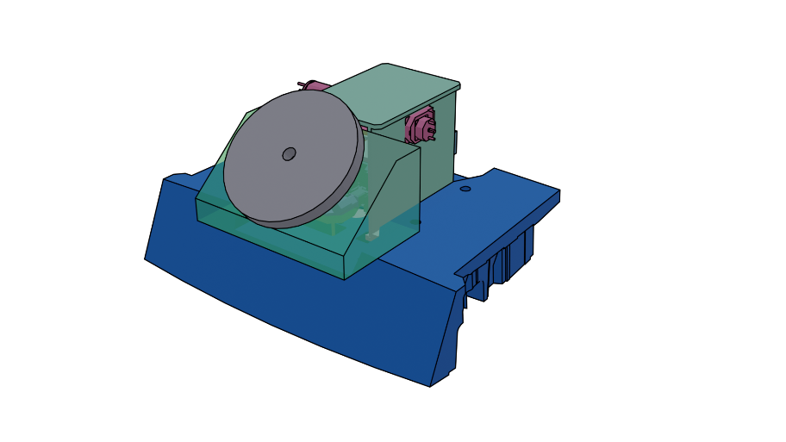
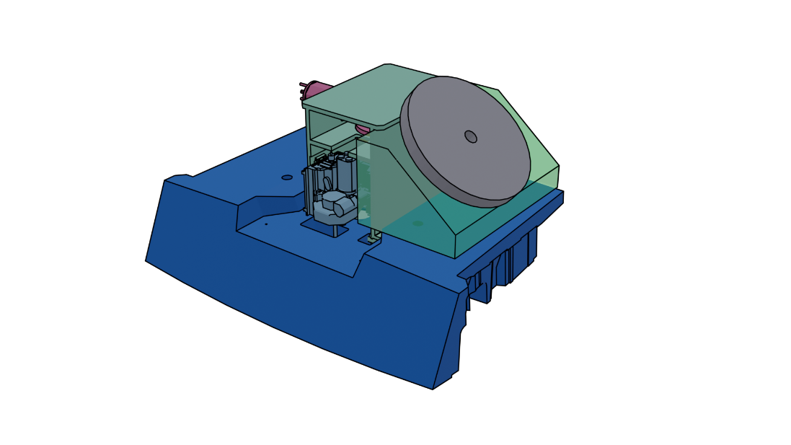



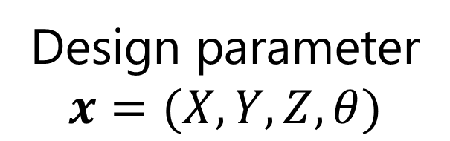

Automated design rationalization of robot component configuration for in-vessel task of ITER Blanket Remote Handling System
T. Iwamoto, Y. Noguchi, N. Takeda
National Institutes for Quantum Science and Technology, Naka-city, Ibaraki-prefecture, Japan
Conclusion
Developed an automated design process to optimize robotic component for ITER Blanket Remote Handling System (BRHS).
Integrated automated re-configuration of component geometry, load reduced path-planning, and Bayesian optimization for efficient design iteration.
Optimized the design of the BRHS components with approximately one-tenth the number of iterations compared to the conventional process.
Component Overview
Developed Method
BRHS and Shield Block Gripper (SBG)
Design process Automation
Design parameter update
Conceptualization
3D model reconfiguration
Bayesian optimization
Kinematics assessment
Detailed design
Kinematics model reconfiguration
Manual process
Load reduced path-planning
First Wall (FW)
Max. 1.0 ton
Shield Block (SB)
Max. 4.0 ton
Automated process
First Wall (FW)
Target modules
Prototype
✘ Limited number of exploration
✓ Extensive exploration
Shield Block (SB)
Manipulator
Load reduced path-planning
RRT* + Minimax optimization
Port
10
6
8
7
20
V_{new}
Blanket Remote Handling System (BRHS)
Manipulator
10
10
V_{original}
_{parent}
V_{new}
Weighted sum
10
6
12
6
12
15
Re-wire
V_{new}
_{parent}
6
18
Edge/Path cost
Re-wire
Sampled node cost
Attach SBG
as End-Effector
Objective function / Bayesian optimization
SB installation
SBG for normal SB
Objective function: $f\left(x\right)=\left\{\begin{aligned}4 \\ S\left(x\right)+L\left(x\right)\end{aligned}\right. \begin{matrix}if path planning failed \\ if path exists\end{matrix}$
Several Types of SBG are required for the BRHS task
Term for compactness
Term for joint load
Kinematic difficulty in SB handling
Design parameters $x$ minimizing this function:
Desirable parameters that achieve both compactness and reduced load.
Several design changes caused kinematic challenging areas in SB handling.
Demonstration and Result
Target
θ
Y
Adding “Offset” structure to SBG
Z
X
Target SB
Torque Evaluated joint
Design parameter
$$x=(X,Y,Z,θ)$$
Result
Samples
Minimum
Covariant ellipse (2σ) of the best 10 % of samples
Adding Offset structure on SBG to ensure/improve kinematics feasibility
Samples Projection to $(Z, θ)$ Plane
Obtained Solution
Conventional design
optimization method
1008 conditions of
grid-search
w/o load reduced
path-planning
Main roll
Pitch roll
Tool roll
Developed design optimization method
100 sampling
w/ load reduced
path-planning
$f\left(x\right): 1.16$
$f\left(x\right): 1.04$
Original, No offset
11.5 kNm
9.7 kNm
7.1 kNm
5.5 kNm
Which offset geometry is reasonable??
⇒ Parameter survey under numerous offset geometry conditions is needed
Required torque comparison
⇒Achieves better optimality with fewer iterations.
11th September 2025 16:00 – 17:30
Presented by IWAMOTO Takuya (iwamoto.takuya@qst.go.jp)
The views and opinions expressed herein do not necessarily reflect those of the ITER Organization.
QSTフュージョンエネルギーワークショップ

