Slide 1

Development of a family of rays tracing code
based on a non-commutative kinetic ray system
Kota Yanagihara¹⁾
¹⁾Naka Institute for Fusion Science and Technology,
National Institute for Quantum Science and Technology

Slide 2
Improving ECRH/CD prediction is important
for high-performance fusion plasmas
Sufficiently localized current drive is required to effectively suppress the NTM [1].
ECCD is an expected actuator, but its prediction is insufficient. Namely, experimental measurements often show broader current profiles than theoretical predictions on geometrical optics [2,3].
Improving geometrical optics has been pursued to fully resolve the discrepancy [4,5,6]. Along these activities, our purpose is to develop a more diffusive ray model and a corresponding code for EC waves.
[1] Hayashi+ NF2004
[2] Yanagihara+ NF2021
[3] Kirov+ PPCF2002
[4] Yanagihara+ PoP2019
[5] Poli+ CPC2018
[6] Weber+ EPJ We. Conf. 2015
1

Slide 3
Focus on the coherence of the RF wave field
【着眼】
既存の準光学理論はEC波の十分な局在とコヒーレンスを要求
→基本の幾何光学に局所展開近似の2次項を導入する拡張
伝搬の過程でEC波は拡幅し、コヒーレンスは徐々に失われ、近似精度は劣化※
→波束スケール未満の媒質変化に起因
そこで波数スペクトルに着目
→拡幅の程度とコヒーレンスを決める
【やったこと】
インコヒーレントな(そして広域に渡る)波動場でも適用可能な枠組みを着想 (pp3-4)
→波数スペクトルの発展を直接的に解く
量子論的な定式化手法を用いてn次精度(但しnは奇数)の相空間光線モデルを導出 (pp5-10)
→空間分布(これまでも考慮)と波数スペクトル(考慮不十分)の対等な取り扱いが目的に合致
→媒質の微細構造によるデコヒーレントと拡幅※は散乱と解釈して記述可能
相空間モデルは1次精度にも関わらず波動性(回折と干渉)を考慮できることを確認 (pp11-15)
→準光学は2次精度への拡張で回折を導入
相空間モデルに基づき計算コードを開発し、準光学と同等の回折効果を確認 (pp16-19)
→散乱と干渉による更なる拡幅が期待
2

Slide 4






Review a conventional ray model
・Wave field is covered by family of rays in real space
・However, “poor” coverage in phase space
→ k-spectra at each x point are not accounted for
→ propagation angle tend to be narrower
Schematic on real space
Map
Schematic on phase space
$$x$$
$$kx$$
wave field $|ψ|2$
antenna
family of rays
$$z$$
$$x$$
$$z0$$
(@z=z₀)
3

Slide 5

“Intuitive” idea for improvement
・Covering the wave field with rays “in phase space” rather than in real space
・Arrayed rays in phase space
↔︎ In real space, rays on each point with various directions
→ Wider propagation angle than conventional model
・Requirement：deductive derivation of this intuitive phase space sketch!!
Schematic on real space
Map
Schematic on phase space
$$x$$
$$kx$$
wave field $|ψ|2$
antenna
family of rays
$$z$$
$$x$$
$$z0$$
(@z=z₀)
4

Slide 6
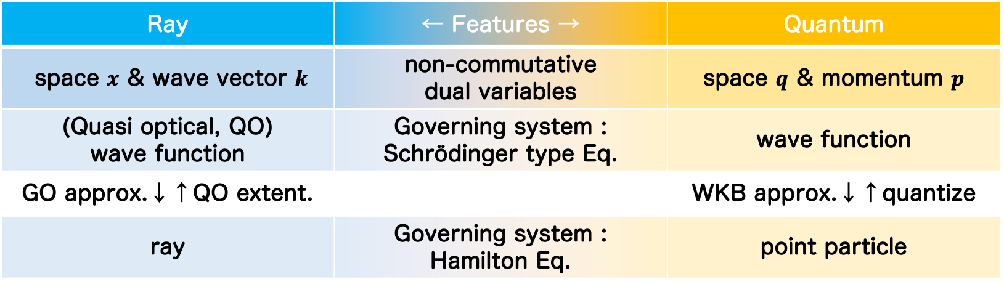
Employ the quantum formalism^{[3]}
[3] Tracy+ Cambridge 2014
・Mathematical structures for ray & quantum theories are quite similar.
・Mathematical methods established in quantum theory should be
useful for our ray-formulation.
・Here we employ the Wigner-Weyl Transform^{[A.1]}, Moyal product^{[A.2]},
and cos-/sin-Moyal bracket^{[A.3]}.
Ray | ← Features → | Quantum
space $x$ & wave vector $k$ | non-commutative dual variables | space $q$ & momentum $p$
(Quasi optical, QO) wave function | Governing system : Schrödinger type Eq. | wave function
GO approx.↓↑QO extent. |  | WKB approx.↓↑quantize
ray | Governing system : Hamilton Eq. | point particle
GO: geometrical optics, QO: quasi-optics
5

Slide 7
Wave action integral leads linear wave equation
Let us start our discussion from the wave action integral $S$generally defined as,
$$S=\int_{−∞}^{∞}{dx}\int_{−∞}^{∞}{dx^{′}}ψ^{∗}\left(x\right)D\left(x,x^{′}\right)ψ\left(x^{′}\right)=\left\langle ψ | \hat{D} | ψ\right\rangle =0,$$
where we Introduced the relations that $D\left(x,x^{′}\right)=\left\langle x | \hat{D} | x′\right\rangle$, $ψ\left(x\right)=\left\langle x | ψ\right\rangle$, and $\int_{−∞}^{∞}{dx \left|\left.x\right\rangle \left\langle x\right.\right|=1}$, to reduce to the abstract form.
$D\left(x,x^{′}\right)$：Dispersion Kernel
$ψ\left(x\right)$：Scalar wave function
Linear wave equations are derived by taking the variations of the integral $δS=0$, respect to bra $\left\langle ψ\right.|$ as,
$$\text{δ}\left\langle ψ\right.| : \hat{D}|\left.ψ\right\rangle =0.$$
6

Slide 8
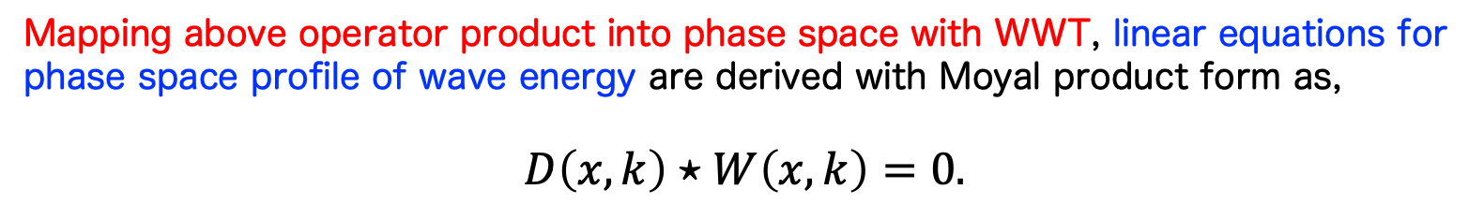
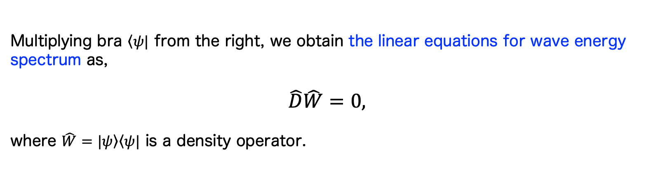
Linear equations for wave energy in ray phase space
Multiplying bra $\left\langle ψ\right.|$ from the right, we obtain the linear equations for wave energy spectrum as,
$$\hat{D}\hat{W}=0,$$
where $\hat{W}=|\left.ψ\right\rangle \left\langle ψ\right.|$ is a density operator.
$$k$$
$$W\left(x,k\right)$$
$$x$$
Mapping above operator product into phase space with WWT, linear equations for phase space profile of wave energy are derived with Moyal product form as,
$$D\left(x,k\right)⋆W\left(x,k\right)=0.$$
Note, the order of the Wigner function $W(x,k)$ is a square of wave function $ψ\left(x\right)$
→ In quantum theory：probability density
→ In ray theory：wave energy density
7

Slide 9
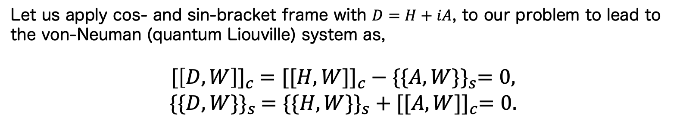
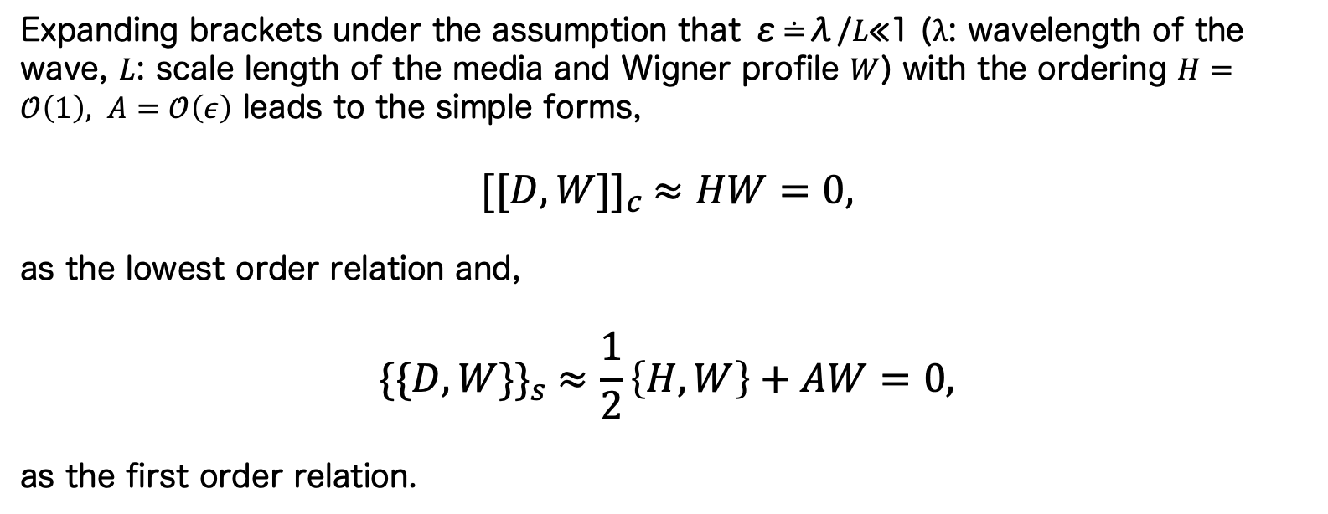
von-Neuman (quantum Liouville) system & its reduction
Let us apply cos- and sin-bracket frame with $D=H+iA$, to our problem to lead to the von-Neuman (quantum Liouville) system as,
$${[\left[D,W\right]]}_{c} ={[[H,W]]}_{c} − {\{\{A,W\}\}}_{s}=0,$$
$${\{\{D,W\}\}}_{s} ={\{\{H,W\}\}}_{s} + {[[A,W]]}_{c}=0.$$
Expanding brackets under the assumption that ε≐λ/𝐿≪1 ($λ$: wavelength of the wave, $L$: scale length of the media and Wigner profile $W$) with the ordering $H=𝒪\left(1\right), A=𝒪\left(ε\right)$ leads to the simple forms,
$${[[D,W]]}_{c} ≈HW=0,$$
as the lowest order relation and,
$${\{\{D,W\}\}}_{s} ≈\frac{1}{2}\left\{H,W\right\}+AW=0,$$
as the first order relation.
8

Slide 10
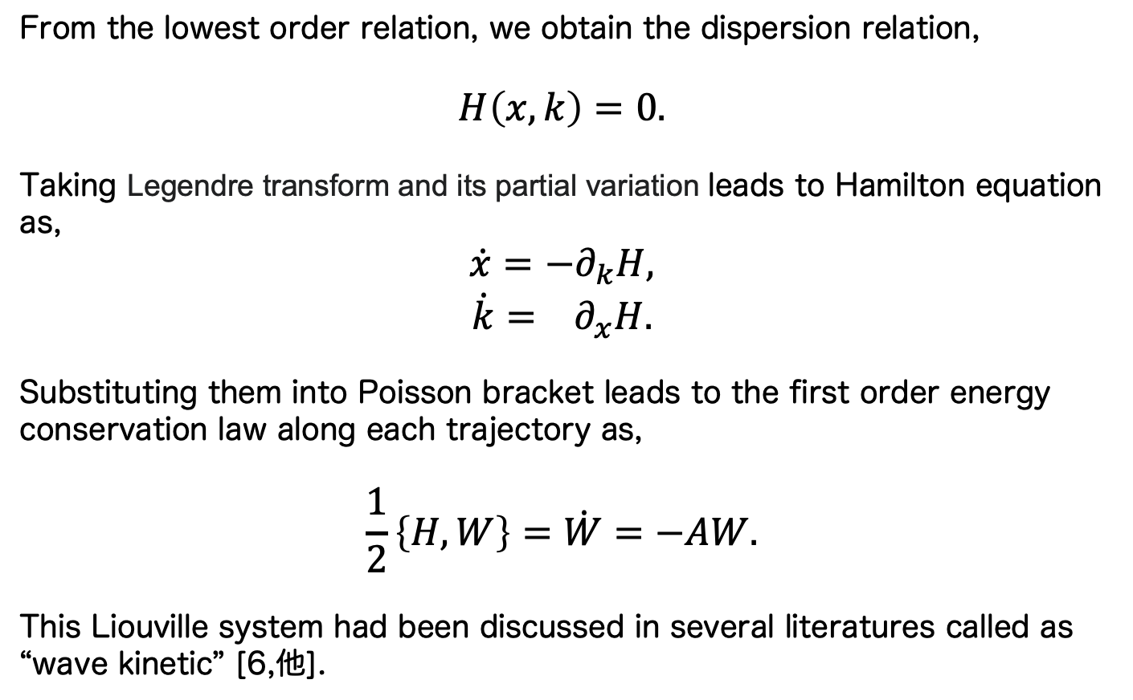
1st order system = well established Liouville theorem
From the lowest order relation, we obtain the dispersion relation,
$$H\left(x,k\right)=0.$$
Taking Legendre transform and its partial variation leads to Hamilton equation as,
$$\dot{x}=−∂_{k}H,$$
$$\dot{k}= ∂_{x}H.$$
Substituting them into Poisson bracket leads to the first order energy conservation law along each trajectory as,
$$\frac{1}{2}\left\{H,W\right\}=\dot{W}=−AW.$$
This Liouville system had been discussed in several literatures called as “wave kinetic” [6,他].
9

Slide 11


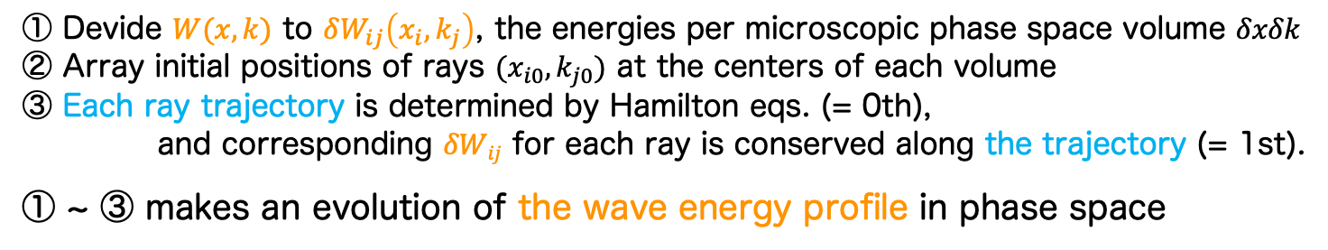






Our intuitive proposal corresponds to
Lagrange-method of Liouville eq.
① Devide $W(x,k)$ to $δW_{ij}\left(x_{i},k_{j}\right)$, the energies per microscopic phase space volume $δxδk$
② Array initial positions of rays $(x_{i0}, k_{j0})$ at the centers of each volume
③ Each ray trajectory is determined by Hamilton eqs. (= 0th),
and corresponding $δWij$ for each ray is conserved along the trajectory (= 1st).
① ~ ③ makes an evolution of the wave energy profile in phase space
$$kx$$
$$kx$$
$$kx$$
①
②
③
$$W\left(x,k\right)→δW_{ij}\left(x_{i},k_{j}\right)$$
$$\left(x_{i0},k_{j0}\right)$$
$$\left(\dot{xi},\dot{kj}\right)$$
$$x$$
$$x$$
$$x$$
※ Since $W$ for wave beam has sufficiently finite profile in phase space,
it is capable to cover the space with finite number of rays.
10

Slide 12
相空間光線群の利点 -記述できる現象の観点から-
①回折
準光学では2次精度で理解される波動性だった
→実空間で記述される幾何光学の高次拡張モデル
相空間光線群では1次精度の範囲で記述される(後述)
→相空間で記述される幾何光学の次元拡張モデル
②干渉
準光学では記述が困難
→妥当性が担保できる光軸近傍から外れた遠方に干渉縞は生じ得る
相空間光線群は記述できる
→広域場に対応+干渉項の導入も容易(後述)
③散乱
準光学では記述が困難
→波束スケール未満の空間構造を仮定しない
相空間光線群は記述できる
→波束の(相空間的な)構造を微小要素に分割する無数の光線それぞれの屈折で表現(後述)
次頁より、これら3つの現象の理論的裏付けと説明を示す
11

Slide 13
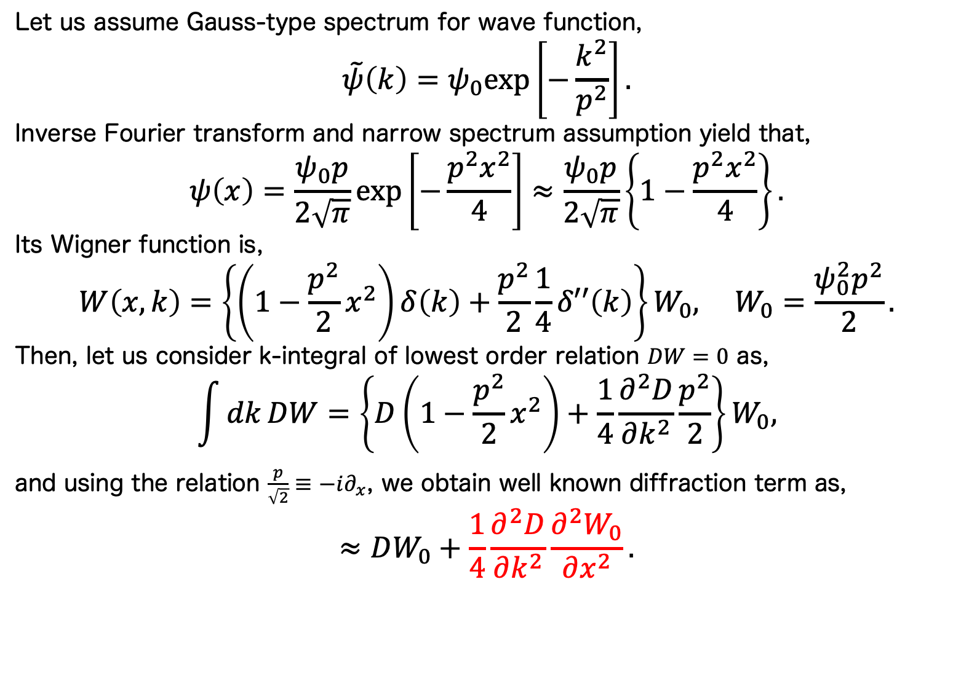
3現象の理論的裏付け：回折
Let us assume Gauss-type spectrum for wave function,
$$\tilde{ψ}\left(k\right)=ψ_{0}exp⁡\left[−\frac{k^{2}}{p^{2}}\right].$$
Inverse Fourier transform and narrow spectrum assumption yield that,
$$ψ\left(x\right)=\frac{ψ_{0}p}{2\sqrt{π}}\exp\left[−\frac{p^{2}x^{2}}{4}\right]≈\frac{ψ_{0}p}{2\sqrt{π}}\left\{1−\frac{p^{2}x^{2}}{4}\right\}.$$
Its Wigner function is,
$$W\left(x,k\right)=\left\{\left(1−\frac{p^{2}}{2}x^{2}\right)δ\left(k\right)+\frac{p^{2}}{2}\frac{1}{4}δ′′\left(k\right)\right\}W_{0}, W_{0}=\frac{ψ_{0}^{2}p^{2}}{2}.$$
Then, let us consider k-integral of lowest order relation $DW=0$ as,
$$\int{dk}DW=\left\{D\left(1−\frac{p^{2}}{2}x^{2}\right)+\frac{1}{4}\frac{∂^{2}D}{∂k^{2}}\frac{p^{2}}{2}\right\}W_{0},$$
and using the relation $\frac{p}{\sqrt{2}}≡−i∂_{x}$, we obtain well known diffraction term as,
$$≈DW_{0}+\frac{1}{4}\frac{∂^{2}D}{∂k^{2}}\frac{∂^{2}W_{0}}{∂x^{2}}.$$
波動場自身が持つ拡散的な現象。ECCD幅の拡幅に寄与。
12

Slide 14
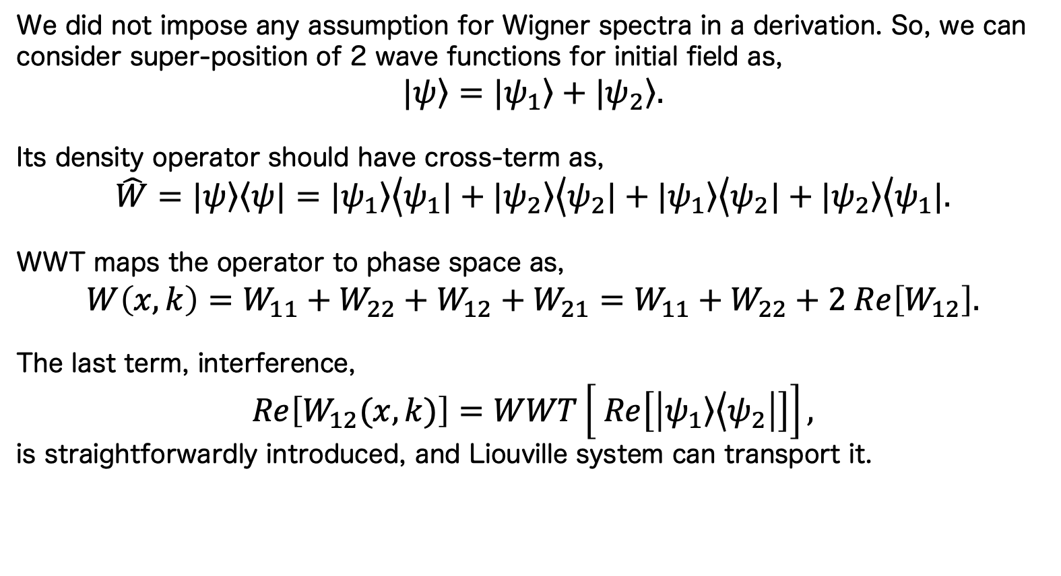
3現象の理論的裏付け：干渉
We did not impose any assumption for Wigner spectra in a derivation. So, we can consider super-position of 2 wave functions for initial field as,
$$|\left.ψ\right\rangle =|\left.ψ_{1}\right\rangle +|\left.ψ_{2}\right\rangle .$$
Its density operator should have cross-term as,
$$\hat{W}=|\left.ψ\right\rangle \left\langle ψ\right.|=|\left.ψ_{1}\right\rangle \left\langle ψ_{1}\right.|+|\left.ψ_{2}\right\rangle \left\langle ψ_{2}\right.|+|\left.ψ_{1}\right\rangle \left\langle ψ_{2}\right.|+|\left.ψ_{2}\right\rangle \left\langle ψ_{1}\right.|.$$
WWT maps the operator to phase space as,
$$W\left(x,k\right)=W_{11}+W_{22}+W_{12}+W_{21}=W_{11}+W_{22}+2 Re\left[W_{12}\right].$$
The last term, interference,
$$Re\left[W_{12}(x,k)\right]=WWT\left[ Re\left[\left|\left.ψ_{1}\right\rangle \left\langle ψ_{2}\right.\right|\right]\right],$$
is straightforwardly introduced, and Liouville system can transport it.
複数系統の入射が常識化するこれからの装置では一考の余地あり。
GHzオーダーなので観測は平均化されて難しく、あまり考えられてこなかった。
しかし電子のジャイロ運動時間スケール~1/Ωcでは有限の影響あるかも？
迷光化する干渉縞によってECCD幅が拡幅している可能性は？
積極活用の可能性も。e.g., phased array antenna.
13

Slide 15
3現象の理論的裏付け説明：散乱
対象とするポテンシャル構造のスケール
高周波の波長以上、波束スケール未満
ここで散乱と呼称する現象
波束が各位置ごとに異なるポテンシャルを感じる
各位置ごとにバラバラな方向に伝搬
波束全体として見るとデコヒーレント・拡幅
一般にはミー散乱の散乱粒子径大近似が対応。
→一般のミー散乱やレイリー散乱は、モヤル括弧の高次奇数項が記述
波動場
流れの向き
波束スケール未満の
媒質(ポテンシャル)の揺動
伝搬方向
14

Slide 16
3現象の理論的裏付け説明：散乱
対象とするポテンシャル構造のスケール
高周波の波長以上、波束スケール未満
相空間モデルではどのように表現
分割エネルギーδW_{ij}の流れはそれぞれの軌道(x_{i},k_{j})に従う
各光線は各位置で異なるポテンシャルを各々直接捉えて屈折
波束全体として見るとデコヒーレント・拡幅
媒質(プラズマ)側の揺動に起因する拡散的な現象。ECCD幅の拡幅に寄与。
→乱流揺動や高波数なMHD揺動
波動場
光線の軌道
波束スケール未満の
媒質(ポテンシャル)の揺動
伝搬方向
15

Slide 17
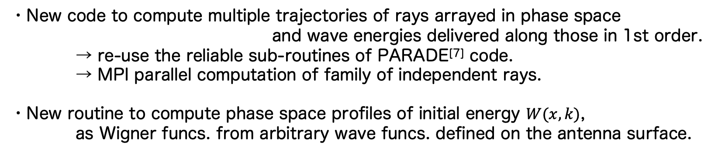
The new code FARANKS：
Family of Rays on Non-commutative Kinetic System
・New code to compute multiple trajectories of rays arrayed in phase space
and wave energies delivered along those in 1st order.
→ re-use the reliable sub-routines of PARADE^{[7]} code.
→ MPI parallel computation of family of independent rays.
・New routine to compute phase space profiles of initial energy $W(x,k)$,
as Wigner funcs. from arbitrary wave funcs. defined on the antenna surface.
[7] Yanagihara+ PoP2020
Z (m)
Example of Gaussian wave beam propagation on JT-60SA plasma at initial-commissioning phase
R (m)
16

Slide 18







Wigner function of initial Gaussian beam field
・Gaussian beam field $ψ(x,y)$ is assumed on antenna surface as initial wave function.
・Using WWT routine, Wigner profile $W(x,y,k_{x},k_{y})$ are computed as follows.
w₀ = 2cm
Z₀ = -30cm
f = 110GHz
$y$ [m]
$k_{y}$ [m⁻¹]
$x$ [m]
$y$ [m]
$k_{x}$ [m⁻¹]
$k_{y}$ [m⁻¹]
$x$ [m]
$k_{x}$ [m⁻¹]
17

Slide 19
Preliminary results -trajectories-
光線軌道群の
各種伝搬モデルによる違い
幾何光学(一本)
幾何光学(複数本/実空間散布)^{濱松相当}
幾何光学(複数本/相空間散布)^{★FARANKS}
Example of Gaussian wave beam propagation on JT-60SA plasma for scenario 5.
リッチなモデルほどより広い発散角の伝搬
波数スペクトルを考慮したことと合致
なお周辺の軌道が小電力な点には注意
18

Slide 20
Preliminary results -ECRH/CD profiles-
電力/電流分布の
各種伝搬モデルによる違い
幾何光学(一本)
幾何光学(複数本/実空間散布)^{濱松相当}
幾何光学(複数本/相空間散布)^{★FARANKS}
準光学(一本/2次精度)^{PARADE}
Power dens.
Current dens.
rho
従来モデルで実空間的に散布した効果は小さい
新モデルで波数方向の自由度を考慮した効果が大きい
従来の準光学と同程度の拡幅効果→散乱と干渉による更なる拡幅が期待
19

Slide 21
Summary
The width of RF wave propagation and absorption in plasma
→ Experiment ＞ Simulation
We focus on the coherence of EC wave field.
Derive a quantum Liouville type phase space rays system using Wigner-Weyl-Moyal formalism. Its first order limit is understood as wave kinetic in several literatures.
confirmed that the derived model can account for diffraction, interference, and scattering, even at the first order.
Develop a first-order phase space ray tracing code, named FARANKS (FAmily of RAys on Non-commutative Kinetic System).
Even the first-order yields a broadening effect comparable to the quasi-optics, because diffraction is introduced. Interference and scattering will make more broad field evolution.
0

Slide 22
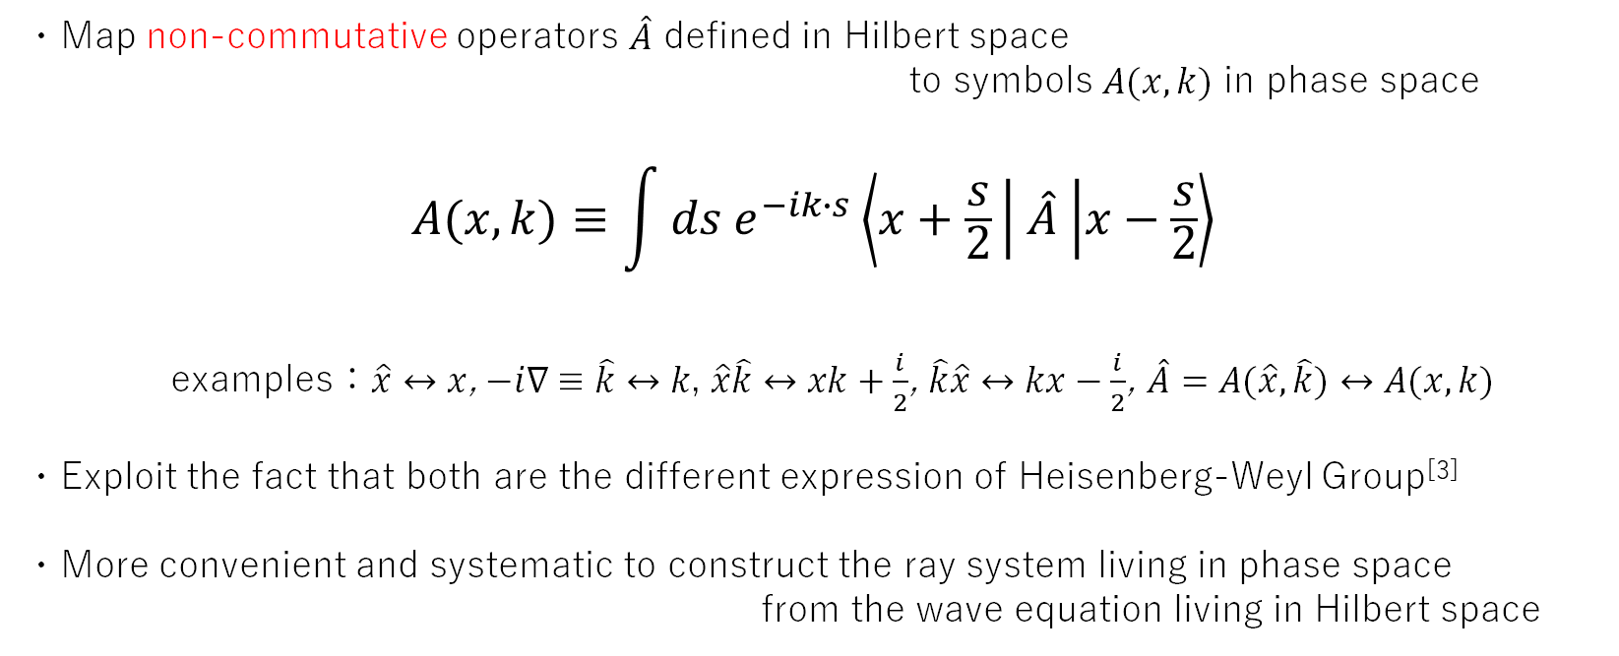
Wigner-Weyl Transform (WWT)^{[3]}
・Map non-commutative operators $\hat{A}$ defined in Hilbert space
to symbols $A(x,k)$ in phase space
$$A(x,k)≡\int{ds e^{−ik∙s}\left\langle x+\frac{s}{2} | \hat{A} | x−\frac{s}{2}\right\rangle }$$
examples：$\hat{x}↔x$, $−i∇ ≡\hat{k}↔k$, $\hat{x}\hat{k}↔xk+\frac{i}{2}$, $\hat{k}\hat{x}↔kx−\frac{i}{2}$, $\hat{A}=A(\hat{x},\hat{k})↔A(x,k)$
・Exploit the fact that both are the different expression of Heisenberg-Weyl Group^{[3]}
・More convenient and systematic to construct the ray system living in phase space
from the wave equation living in Hilbert space
A.1

Slide 23
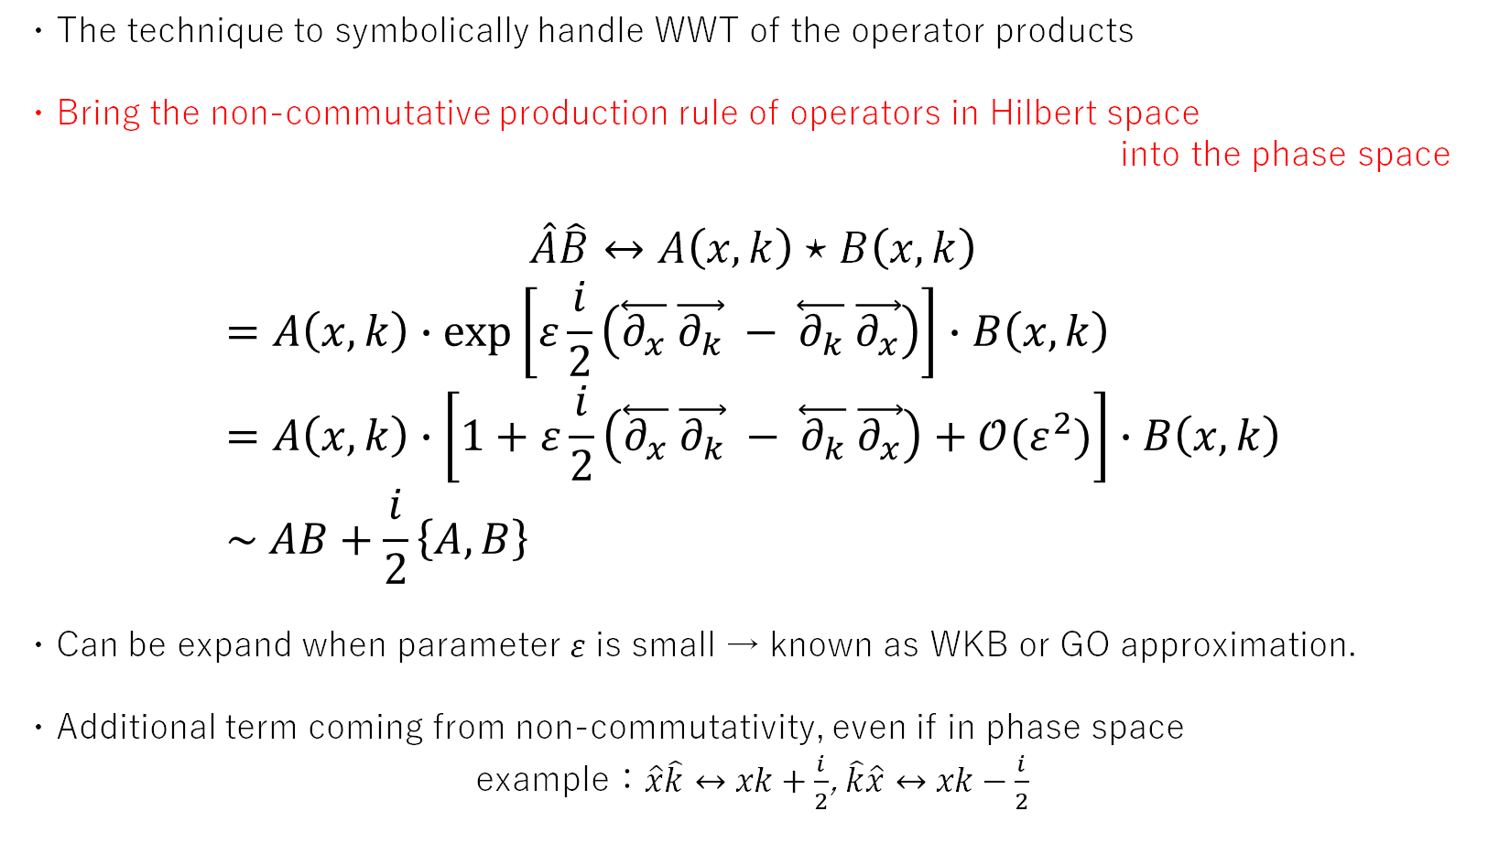
Moyal product^{[3]}
・The technique to symbolically handle WWT of the operator products
・Bring the non-commutative production rule of operators in Hilbert space
into the phase space
$$\hat{A}\hat{B}↔A\left(x,k\right)⋆B\left(x,k\right)$$
$$=A\left(x,k\right)∙\exp\left[ε\frac{i}{2}\left(\overset{⃖}{∂_{x}} \vec{∂_{k}} − \overset{⃖}{∂_{k}} \vec{∂_{x}}\right)\right]∙B\left(x,k\right) \\ =A\left(x,k\right)∙\left[1+ε\frac{i}{2}\left(\overset{⃖}{∂_{x}} \vec{∂_{k}} − \overset{⃖}{∂_{k}} \vec{∂_{x}}\right)+𝒪(ε^{2})\right]∙B\left(x,k\right) \\ \sim AB+\frac{i}{2}\left\{A,B\right\}$$
・Can be expand when parameter 𝜀 is small → known as WKB or GO approximation.
・Additional term coming from non-commutativity, even if in phase space
example：$\hat{x}\hat{k}↔xk+\frac{i}{2}$, $\hat{k}\hat{x}↔xk−\frac{i}{2}$
A.2

Slide 24
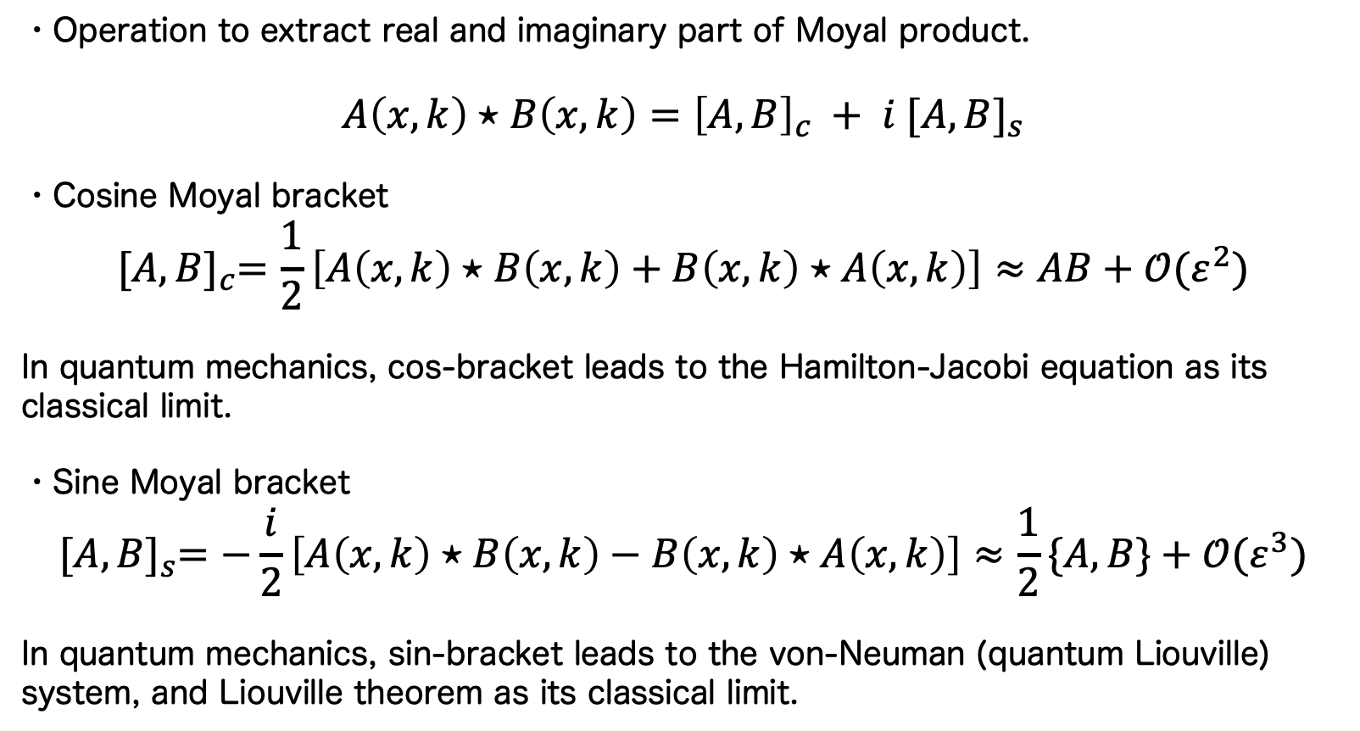
Cosine and sine Moyal bracket
・Operation to extract real and imaginary part of Moyal product.
$$A\left(x,k\right)⋆B\left(x,k\right)={\left[A,B\right]}_{c} + i {[A,B]}_{s}$$
・Cosine Moyal bracket
$${[A,B]}_{c}=\frac{1}{2}\left[A\left(x,k\right)⋆B\left(x,k\right)+B\left(x,k\right)⋆A\left(x,k\right)\right]≈AB+𝒪(ε^{2})$$
In quantum mechanics, cos-bracket leads to the Hamilton-Jacobi equation as its classical limit.
・Sine Moyal bracket
$${[A,B]}_{s}=−\frac{i}{2}\left[A\left(x,k\right)⋆B\left(x,k\right)−B\left(x,k\right)⋆A\left(x,k\right)\right]≈\frac{1}{2}\{A,B\}+𝒪(ε^{3})$$
In quantum mechanics, sin-bracket leads to the von-Neuman (quantum Liouville) system, and Liouville theorem as its classical limit.
A.3

